Slide 1
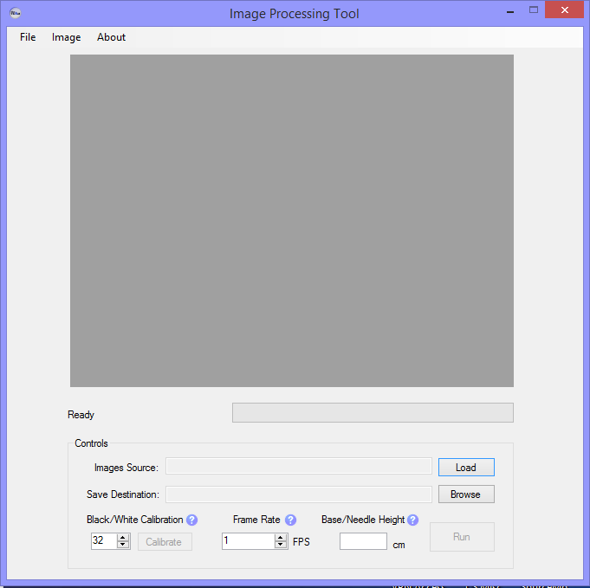
Demonstration
Load Images
Name Output File
Calibrate Processed Image
Run data set
Enter frames per second
Enter distance between base/needle if known
Notes:
Then actually demo – use data set that required sensitive calibration.

Slide 2
Test Report
Deviations from Requirements
Known problems
Efficiency may not be improved
Processing time up to 2.5x longer vs Version 1.0
From ~1 min to ~2 min
But more robust, accurate
Determined location of needle/ratchet for each image
No need for consideration of camera position – can safely assume is constant
Run – Stop – Run again sequence may interrupt thread processes – cause crash
Similar issue with Exiting Tool during IO
Base/Needle height may not be measured accurately, will affect results
Notes:
Test Report – known problems; deviations from reqs

Slide 3
Hypothetical – Anne
What if we had more time?
Improve processing time, design of interface (change color scheme of form), ensure customer satisfication
What if we could start over?
Would start coding sooner
Plan/work on more defined, divided goals/milestones
Interact more with customer
What I learned
Image processing/manipulation through C#
Software Engineering Documentation
Team work/brainstorming

